Slide 1

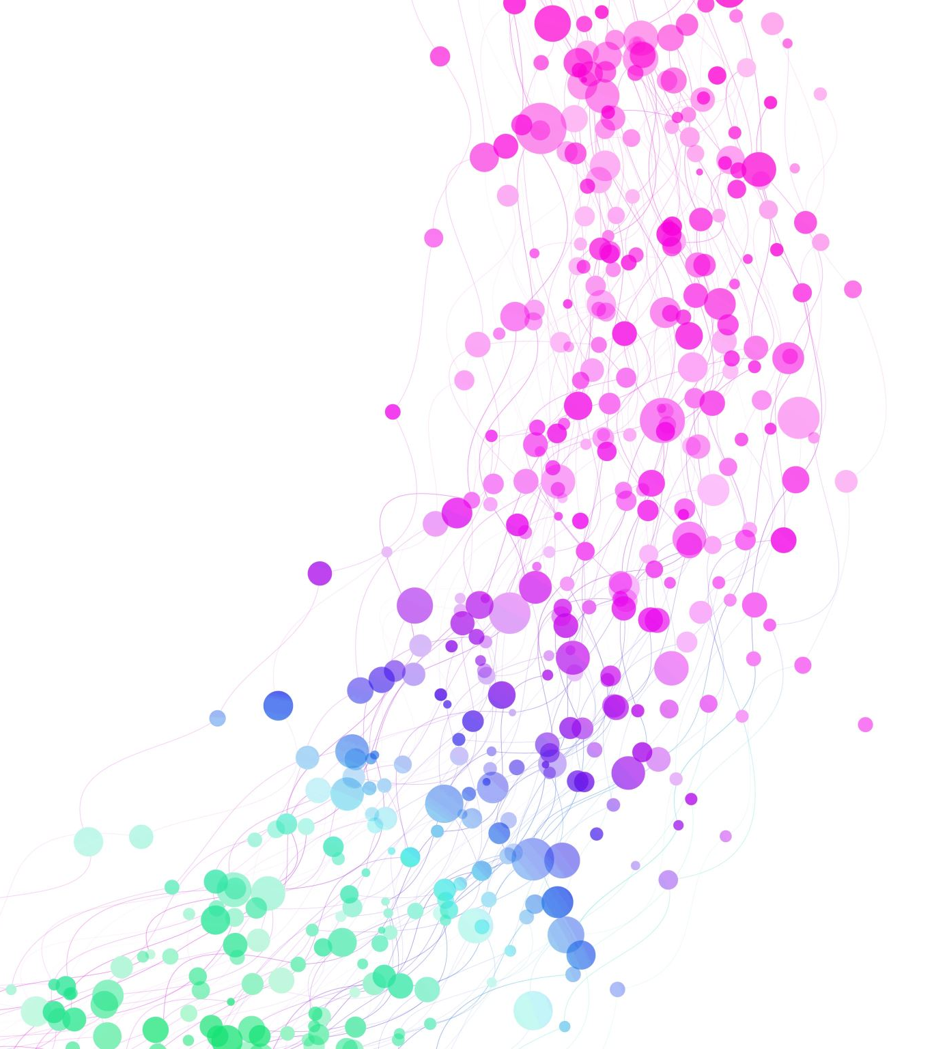
Sprint 4
Gowtham Raj K R

Slide 2

AGENDA
What is DevOps?
Agile vs DevOps
Networking
OSI Model vs TCP/IP Model
TLS Handshake
Scrum vs SAFe
What is Bamboo?
What is Terraform?

Slide 3
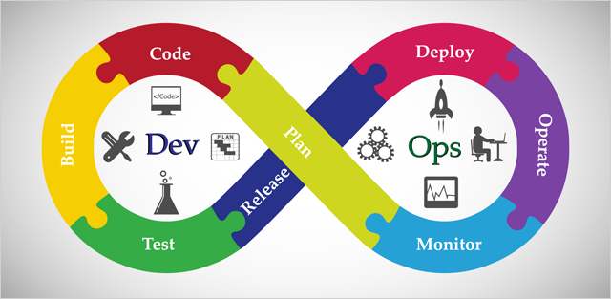
What is DevOps?

Slide 4
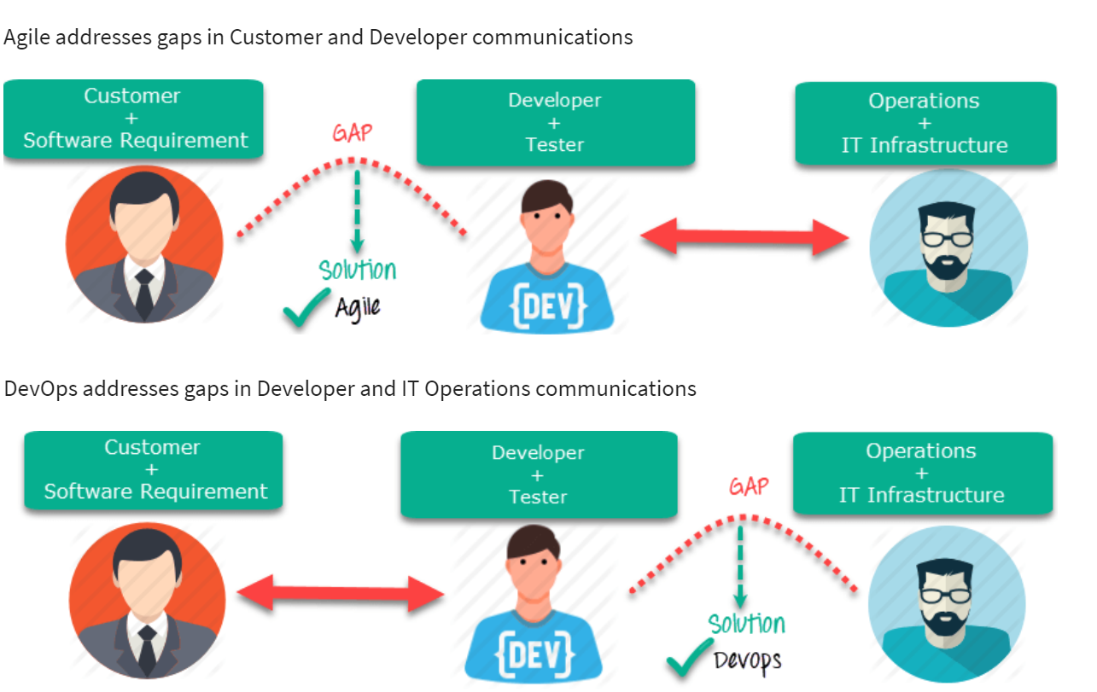
Agile vs DevOps

Slide 5

What is Networking?

Slide 6
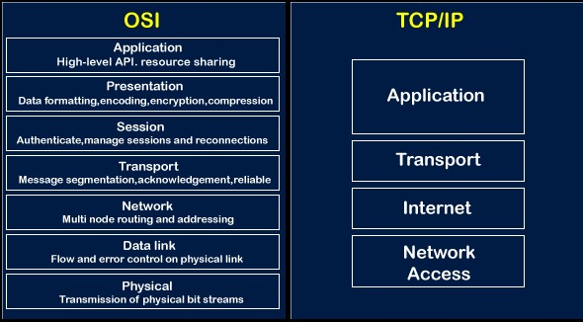
OSI Model vs TCP/IP Model

Slide 7
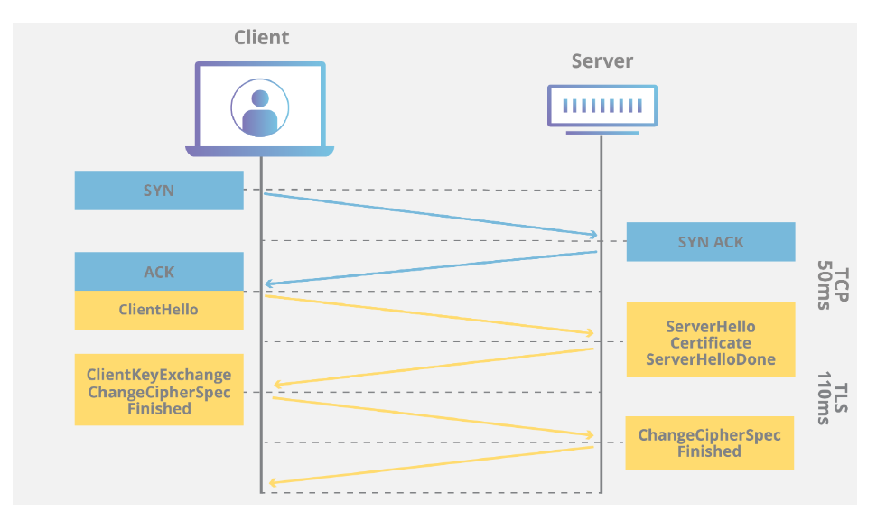
TLS HandShake between Client and Server

Slide 8

What is JIRA?

Slide 9

Scrum vs SAFe

Slide 10
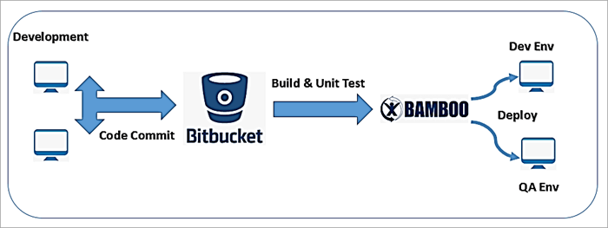
What is Bamboo

Slide 11
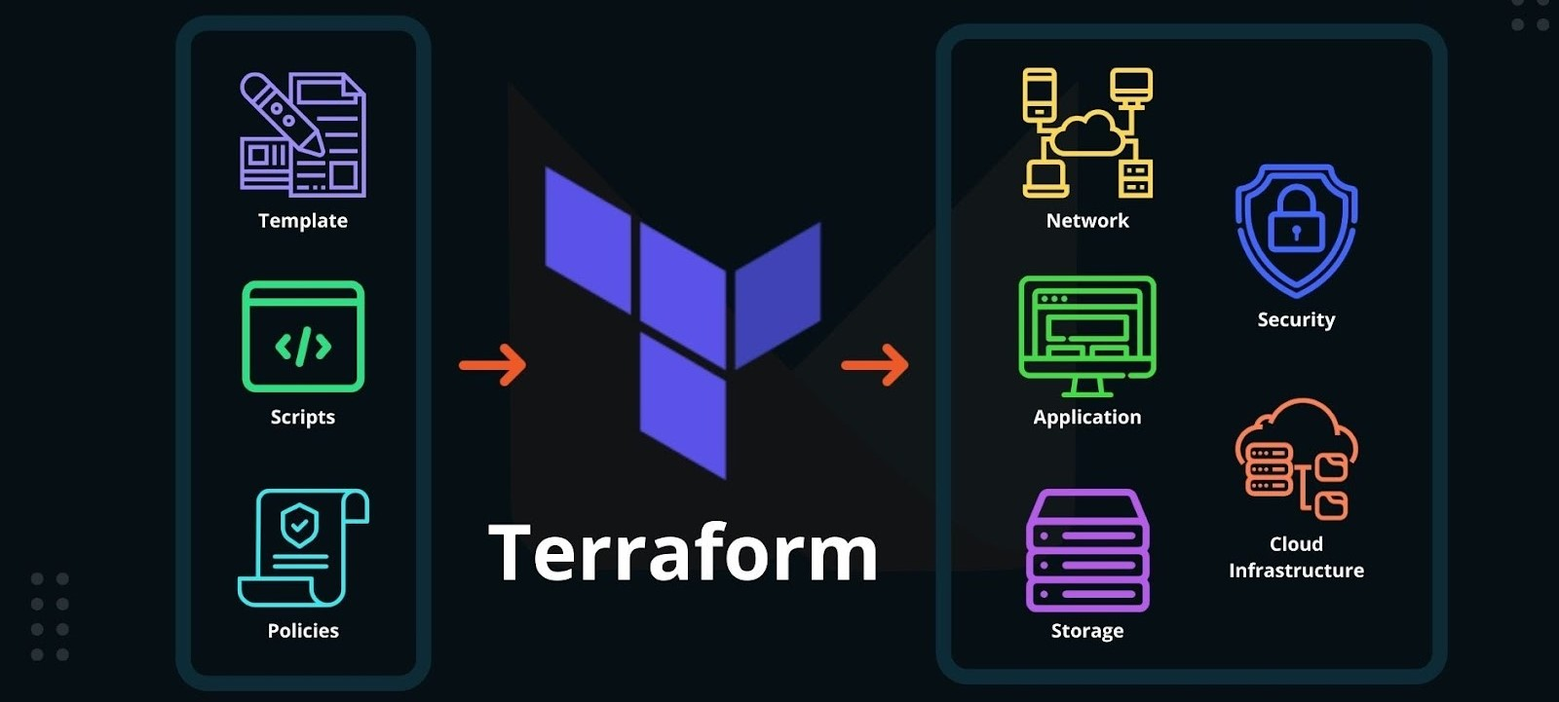
What is Terraform?

Slide 12


